Slide 1
Team briefing August 2023

Slide 2
Transformation brand
Our brand is important as it enables us to tell a story about our evolution over the next few years.
It will visualise how the future Mole Valley District Council will feel, including what kind of organisation we will be.
The logo represents our ambition of MVDC being ready for a bright, digital future.
Evolve 2026’s four supporting pillars:
Notes:
Evolve 2026 is based on these 4 strategies to support the transformation programme
Service Transformation Strategy : considers end-to-end systems, not individual processes, and embeds a continuous improvement culture while ensuring better value for money
People Strategy: (its about how we will train and prepare our employees) Supporting new ideas, technologies and changes will inevitably impact what we do and how we do it. This will require us to adapt and develop new skills and ways of working
Customer Engagement: customer focus in everything we do
Digital Strategy: Changes will require new processes and workflows. The Digital Strategy will support these changes.

Slide 3
‘Shift Left’ ambition
Shift left ambition
65%
25%
8%
2%
E-enabled service (e.g. Web, e-forms, apps, portals)
Dedicated contact centre
Expert teams
Strategic level resource
Customer
Cost

Slide 4
Service reviews
09 Major Groups
359 ideas in the major groups
437 Ideas
24 Service Reviews
From 5th June to 7th July
Notes:
All service returns were received by the end of May and were analysed by Transformation team and Finance. In total there were 24 service returns completed giving us a capture in time of MVDC services. All through June and finishing the first week of July the Service review deep dive sessions were held this was so we could explore further the potential opportunities for improvement. This process generated around a further 150 ideas for improvement and gave us a good understanding of all departments. Feedback received from BMT managers through this process was good as many saw it as a useful exercise to step back and consider future needs of their service area.
Since closing the service review process the transformation team have worked hard to categorise and organise the ideas. This has resulted in identifying 11 major themes for programmes to bring in the change you have identified for our council. These themes capture most of the ideas into major programmes of work leaving just 27 ideas that would be considered as standalone projects.
SLT have looked at these ideas and have asked that the vast majority are taken forward to be considered as part of the business cases development.

Slide 5
Finance transformation
Sweating the assets
Strategic reduction
Process improvements
Shift left (My Account)
Procurement
Partnerships
Property Efficiencies
Fees & Charges
Themes
Parks & open spaces review
Dorking halls review
Fairfields review
MOVA review
Pippbrook
Campus review
Notes:
The 9 major themes are as follows:
Finance transformation – appeared in most service reviews. This programme will look at improved processes, potential for Shared Services to aid resilience and systems enhancement.
Property efficiencies – similar to the finance programme this will enable us to look across the service for ways to improve what we do.
Procurement – this will allow us to conduct a compliance review, create an accurate contracts database and renegotiate and consolidate our contracts.
Shift Left – this will focus on making sure that customer contact is undertaken in the most cost effective way possible with a significant move to online transactions to offer 24/7 service
Fees & charges – many of you said that there was greater scope to increase what we charge for the services we deliver. We can see across the county that most D&B’s are looking into this also. We will be devising an approach that allows us to better cost our services to understand what we should be charging.
Strategic reduction – this is looking at making sure that we make a choice for areas of our work that we are not obliged to do. Much of the things we do on a discretionary basis are value add so unlikely to be impacted now. However, there were some clear things you told us that it would make sense to either reduce or cease. For example we currently hold a stock of litter picking equipment that we handle the logistics for if ever a community group requests access to these. It makes sense for us to continue to support groups wanting to help keep our district clean, but rather than complex and resource intensive ways to manage this we will look at simpler cheaper ways to provide the same support.
Partnerships – several examples came up where partnerships are a potential to offer us more resilience and benefits in working with other councils. Partnerships are complex and so we want to develop a partnership approach for Mole Valley DC and be clear on our principles for a successful partnership arrangement.
Process improvements collects all of those processes that you have told us could benefit from review. As mentioned these will be prioritised and worked through based on the impact they will have to our council.
Lastly and our most significant area of work will be to look at how we can get the most from our assets. The sub groups shown are where there was considerable input from you all on ways we can make the most from these areas of our portfolio. Each of these including a separate look at assets in general will have a paper that SLT will use to evaluate the options for the strategic approach to our assets.

Slide 6
Importance of CI on our future
TRANSFORMATION | CONTINUOUS IMPROVEMENT
Major change High Investment Entrepreneurial risk Specialized team Long term Management decision | Small steps Minor investment Low risk Involvement of people Short term Team decision approved by management
Transformation
Continuous
Improvement
Improvement
Improvement
Time
Time
Notes:
As we have maintained in earlier presentations to you all there will be two tramlines of work for transformation. The first is the transformation programmes which are likely to be our themes of work mentioned in the previous slide. The reason these are placed into this category is due to the fact that these are usually complex and involve major change in what we do. They almost always require investment to make the change happen, carry higher risk and therefore require closer monitoring and need strategic oversight for direction and decision. Due to the complexity, they will require a temporary dedicated project team to drive forward the plan and tend take longer than a year to complete.
Continuous improvement in contrast are the much less complex and take less effort to achieve. This allows us as an organisation to take small incremental steps to progress quick initiatives that help make our services better. These improvements will have either no or at the most very minimal investment to make happen. They tend to be small changes to operation such as a revision to process or introduction of an e-form and by their nature are lower risk to the organisation. As such often the decision making can be less formal and can be made at department level and initiatives can be implemented in shorter timescales.

Slide 7
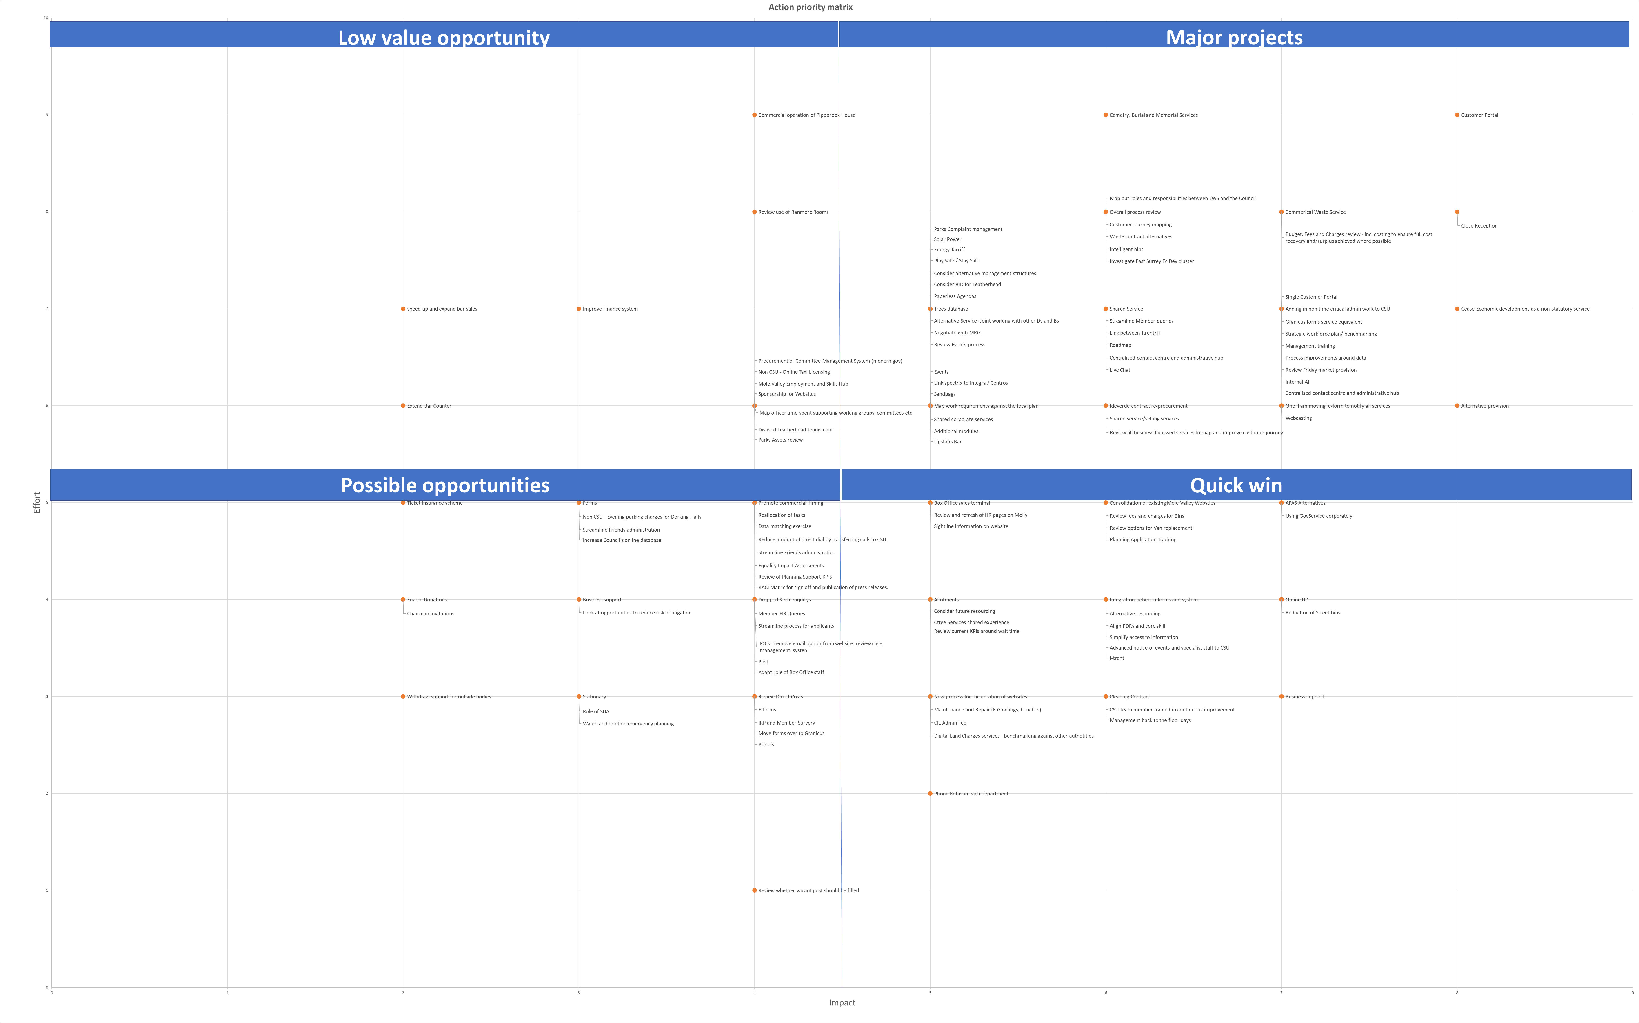
Importance of CI on our future
Transformation
Programme
Effort
Continuous
Improvement
Impact
Notes:
In order to try and identify what type of approach to take with each of the ideas we are able to use an action priority matrix.
Where ideas have considerable effort to achieve but have significant impact to our council priorities these will be our transformation projects. We can expect that most of the major themes will fall in this area. Where the effort is less these will form our pipeline of continuous improvement opportunities and they will be prioritised by those that have the highest impact to our council.

Slide 8
Key dates
Scoping documents 10th Aug
Business cases 7th Sept
Member reference 27th Sept
Cabinet sign off 28th Nov
Notes:
The last thing to look at is some of the key dates ahead of us.
August will be a busy period as we look to confirm our projects that will be taken forward. The first step in this process will be the scoping documents. This will take all the major themes and start to expand on what the project would look to achieve. The scoping documents will look at the benefits we can expect, risks that might emerge, the amount of investment that will be needed to make it happen and an estimate of the savings that the project will bring. SLT will use this information to further rationalise the number of projects that progress to the next stage.
This next stage will be the development of the project into a full business case. This will give us much more certainty on the project elements explored through the scoping document and detail the project team needed. The business cases will then be assessed and SLT will make the final decision on what will be taken forward as part of transformation.
Once the programme is locked in from an officers perspective we will begin engagement with members over Sept & October. Where we will need member approval will be where the projects have a significant resident or business impact and/or have the need for investment beyond the agreed budgets. We will use the newly formed member reference group to help shape the projects that have an external impact and any additional funding will be agreed at cabinet at the end of November.

Slide 9
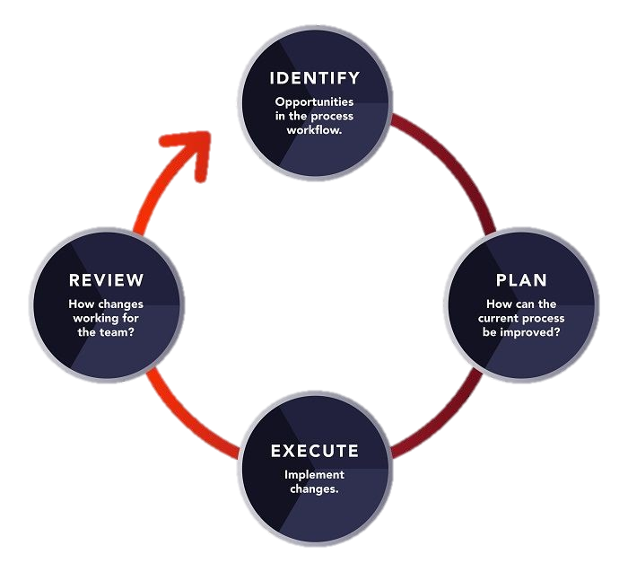
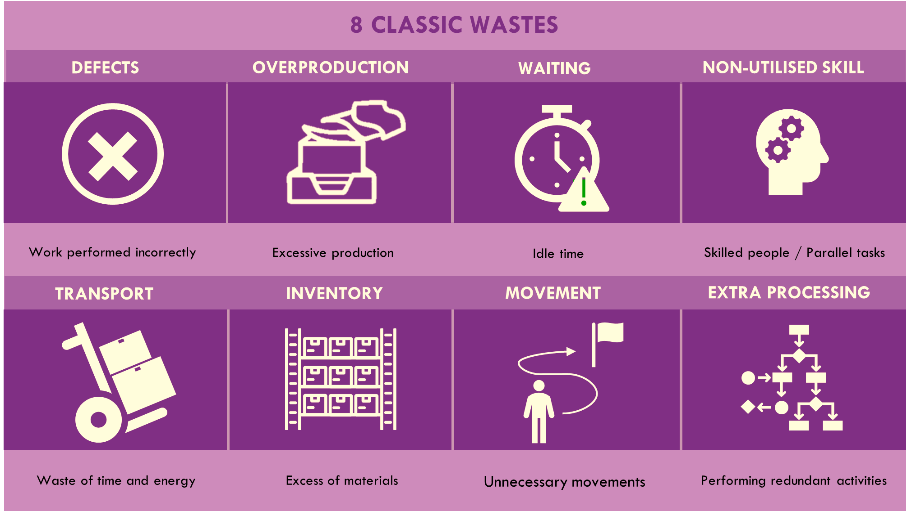
∞
Continuous Improvement
K a i z e n
!
Change
Better
C
C3
C
C2
C3
C1
C2
C1
Notes:
Scientific methodology is a step-by-step approach that scientists use to learn about the world and answer questions through careful observation, experimentation, and analysis.
CI comes from the Japanese Term – KAIZEN (Cientific Methodology)
When a cycle ends - another cycle starts to improve what was not addressed in the previous cycle
Continuous Improvement main focus is streamline workflows by removing/reducing waste – consequently we will reduce frustration at workplace and increase staff and customer satisfaction
Waste example – Mole Valley Life process (Defect, Overproduction and Waiting)
New habits can be created and maintained through small daily changes - Elimination of waste using cheap tools relying on colleagues' motivation and creativity to improve processes

Slide 10
Change
does not always result in
Change
$$≠$$
Improvement
requires
The problem is always having the same problems
Notes:
Not every change results in improvement
Continuous Improvement Methodology is the learning process to be used by the organisation to identify changes that have the potential to lead to improvements.

Slide 11
Key Performance Indicator (KPI)
KPIs assist in monitoring the organisation performance by revealing gaps between planned and executed goals
Notes:
KPI monitoring importance 143 Local Government KPIs & Scorecard Measures | ClearPoint Strategy
Key Performance Indicators (KPIs) play a crucial role in the success of a continuous improvement strategy within an organization. They give us clear goals to measure progress, find things we can do better, and make the whole company work better.
Examples:
Average Number of Customer Complaints per Week
Resident Satisfaction
Employee Satisfaction Index
Unemployment Rate
Average Number of Hours to Complete Service Desk Request

Slide 12
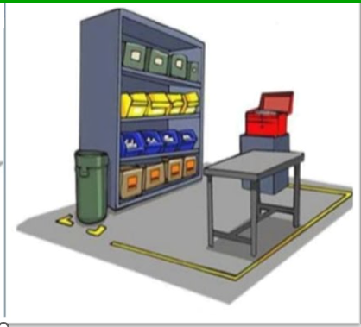
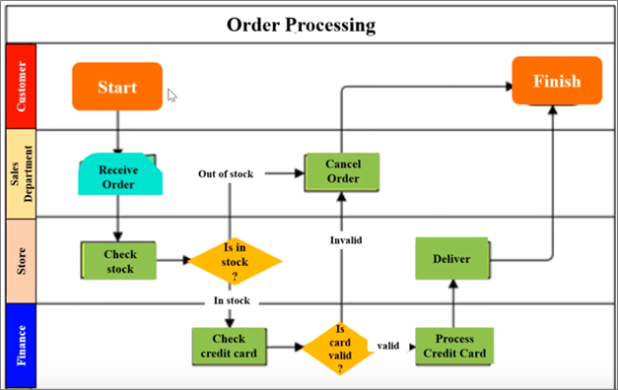
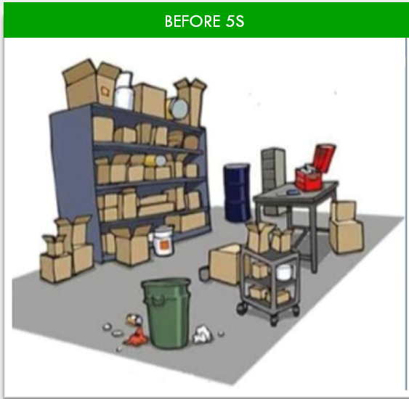
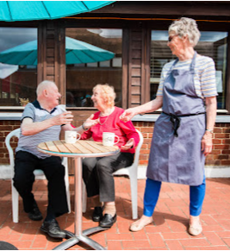
Tools and Techniques
Root cause analysis
Failure demand
Automation
Reduction in time spent on admin activities
Customer insight
Process Mapping
AFTER 5S
BEFORE 5S

Slide 13
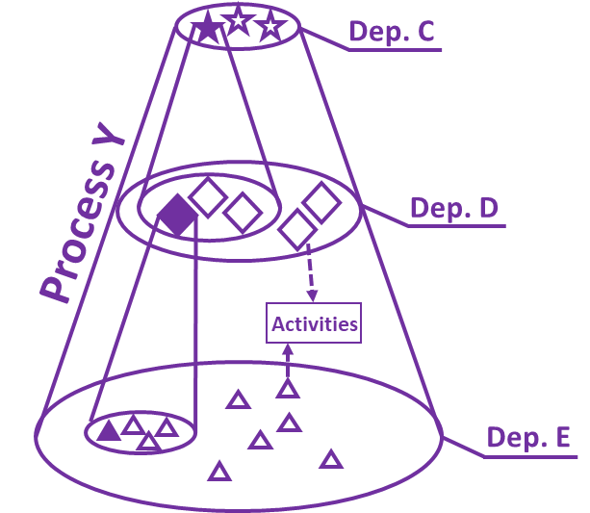
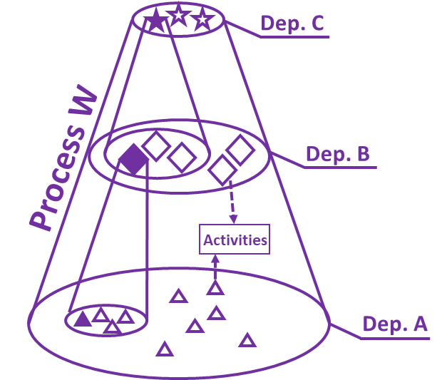
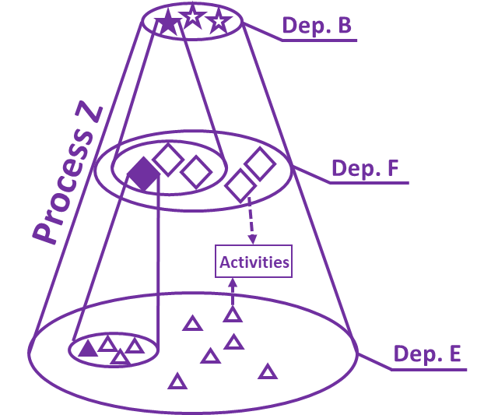
Process Oriented
MVDC System
Process
Dep. A
Activity
Process X
Dep. B
Activities
Task
Dep. C
Process is the entire set of things a company does to deliver valuable outcomes
Notes:
Systems thinking
Cross-departmental workshops

Slide 14
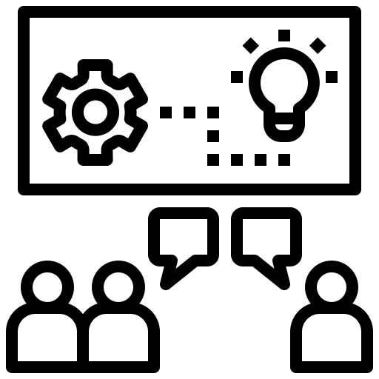
Continuous Improvement Workshop
Local Knowledge
No Judgement
Focus on Solution
Process Flow
Blockadge Elimination
Teamwork
Staff and Customer Centricity
Notes:
Local knowledge + Theory (CI Methodology)
No judgement - No idea is a bad idea – Safe environment where everyone feels empowered to contribute to meaningful decision-making
Focus on solution, not interrested in poiting fingers
CI focuses on creating flow by eliminating waste
Waste: small problems that result in operational inefficiency and frustration
Process oriented – cross departmental
Systems Thinking and Process Oriented Approach

Slide 15
Personas Workshop
What?
Profiles that represent a particular group of people (customers, users, employees or any other stakeholder).
What is the purpose?
The idea is to understand our users’ needs, experience, behaviours, challenges and goals.
Represent our customers now and in the future
Identify, based on our expertise:
Who is using our services
What is motivating them to do so
Pain point
8
Workshops
18 Profiles
20 Departments
53 Participants
Notes:
Personas are Profiles that represents a particular group of people (CUSTOMERS, USERS, EMPLOYEES OR any other STAKEHOLDER)
The idea is to understand our users’ needs, experience, behaviours, challenge and goal
Is a visual representation of a set of users that help us to visualize, understand, and build relevant connections with the target users.
Why: For us start thinking about the customer and how decisions impact them. Its about understanding our customers and how well our current services meet their needs
Who: Experts in the subject come together to understand our daily customers and identify shared characteristics.
Creating personas will help us to identify and understand the users we are designing for. Focus on Customer Experience

Slide 16
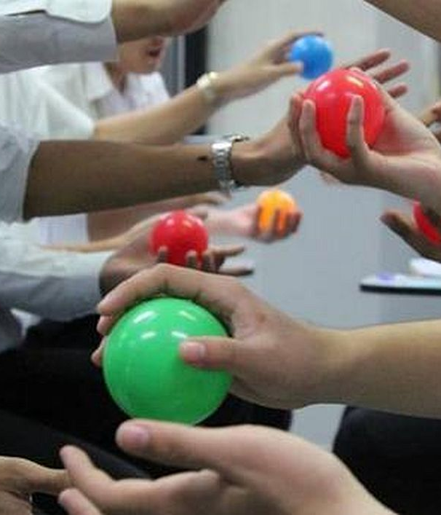
Continuous Improvement Game
The Ball Point Game
Rules:
The ball must have airtime
Everyone must touch the ball
It must follow the same pattern each time
Start Point is the End Point
Notes:
Possible questions for debriefing. (five iterations.)
What did you learn from the game?
How did the team make decisions?
How would things have gone differently if the team had an appointed leader?
How important were retrospectives?
Did you realize stress? – When?
Why reduce dropped balls the final result? – Meaning of defect handling.
Which team dynamics did you experience?
Systems Thinking and Process Oriented Approach
The Ball Game The Ball Game - A Creative Team Building Exercise – YouTube https://www.youtube.com/watch?v=rva3wRvpS_4 or How to run the Ball point game – YouTube https://www.youtube.com/watch?v=UnMWEnt6yGM
Having trouble keeping all your balls in the air? There’s a game for that…
What is The Ball Game all about?
The Ball Game is all about eliminating waste in your company activities and continuously improving processes.
In 2 groups, of no less than 5, all you need to do is pass 3 balls between the 5 of you in the same pattern. Sound simple enough? How quick do you think you can do it? Less than a minute? Not bad. Not as good as 0.5 seconds though. I can hear you saying “0.5 seconds? No, surely not! It takes me 0.3 seconds to blink!!” Let’s look at the process.
This game could be a simulation of any process. From onboarding staff and clients to the Accounts Payable Process. The Ball represents the task and the movement represents how the responsibility passes from team member to team member.
The only rules were:
The ball has to have air
Everybody must touch the ball
It must follow the same pattern each time
Start Point is the End Point
One set of our clients re-examined their process and decided that crossing the table wasted too much time. They lined up and tried again. This process of Plan Do Check Act, allowed them to trial and error different approaches. This method took 21 seconds. After a few more tries they got it down to 0.5 seconds. Now you’re thinking “this is not possible, tell us how!!” One member of the team stood in the middle of the group, the other members in a circle round the outside. The member in the middle held the three balls in one hand, the members on the outside held out their opposite hands. Touching each member’s hand with the three balls, the middle member span round in a circle. Phenomenal.
Questions to consider:
Imagine cutting all the waste out of your process so that it takes 1/112 of the original time.
Which processes in your business could be Leaned?
Is there a lot of waste in a process because “that’s the way its always been done”?
Skills, tools and techniques the Ball Game may help you with include Communication, Continuous Improvement, Flow, PDCA, Teamwork and the Eight Wastes.
Questions: Ball Point Game - Introducing Agile By The Fun Way • Plays-In-Business https://www.plays-in-business.com/ball-point-game-introducing-agile-by-the-fun-way/

Slide 17
Continuous Improvement Game
The Ball Point Game
TEAM 01
Round | Time
1 |  | Seconds
2 |  | Seconds
3 |  | Seconds
4 |  | Seconds
5 |  | Seconds
TEAM 02
Round | Time
1 |  | Seconds
2 |  | Seconds
3 |  | Seconds
4 |  | Seconds
5 |  | Seconds
TEAM 03
Round | Time
1 |  | Seconds
2 |  | Seconds
3 |  | Seconds
4 |  | Seconds
5 |  | Seconds
Notes:
Possible questions for debriefing. (five iterations.)
What did you learn from the game?
How did the team make decisions?
How would things have gone differently if the team had an appointed leader?
How important were retrospectives?
Did you realize stress? – When?
Why reduce dropped balls the final result? – Meaning of defect handling.
Which team dynamics did you experience?
Systems Thinking and Process Oriented Approach
The Ball Game The Ball Game - A Creative Team Building Exercise – YouTube https://www.youtube.com/watch?v=rva3wRvpS_4 or How to run the Ball point game – YouTube https://www.youtube.com/watch?v=UnMWEnt6yGM
Having trouble keeping all your balls in the air? There’s a game for that…
What is The Ball Game all about?
The Ball Game is all about eliminating waste in your company activities and continuously improving processes.
In 2 groups, of no less than 5, all you need to do is pass 3 balls between the 5 of you in the same pattern. Sound simple enough? How quick do you think you can do it? Less than a minute? Not bad. Not as good as 0.5 seconds though. I can hear you saying “0.5 seconds? No, surely not! It takes me 0.3 seconds to blink!!” Let’s look at the process.
This game could be a simulation of any process. From onboarding staff and clients to the Accounts Payable Process. The Ball represents the task and the movement represents how the responsibility passes from team member to team member.
The only rules were:
The ball has to have air
Everybody must touch the ball
It must follow the same pattern each time
Start Point is the End Point
One set of our clients re-examined their process and decided that crossing the table wasted too much time. They lined up and tried again. This process of Plan Do Check Act, allowed them to trial and error different approaches. This method took 21 seconds. After a few more tries they got it down to 0.5 seconds. Now you’re thinking “this is not possible, tell us how!!” One member of the team stood in the middle of the group, the other members in a circle round the outside. The member in the middle held the three balls in one hand, the members on the outside held out their opposite hands. Touching each member’s hand with the three balls, the middle member span round in a circle. Phenomenal.
Questions to consider:
Imagine cutting all the waste out of your process so that it takes 1/112 of the original time.
Which processes in your business could be Leaned?
Is there a lot of waste in a process because “that’s the way its always been done”?
Skills, tools and techniques the Ball Game may help you with include Communication, Continuous Improvement, Flow, PDCA, Teamwork and the Eight Wastes.
Questions: Ball Point Game - Introducing Agile By The Fun Way • Plays-In-Business https://www.plays-in-business.com/ball-point-game-introducing-agile-by-the-fun-way/

Slide 18
Continuous Improvement
PDCA Cycle
Check and Act
DO
Plan
Implement Positive Changes
Test Small
Plan
Continuous Improvement in Action
Problem Identification
Notes:
PDCA Cycle stands for Plan, Do, Check and Act

Slide 19
Continuous Improvement Forum
Online Portal – Idea Submission
CI Group – Review Submissions
CI Champions – Staff members
from across the organisation
CI training and workshops

Slide 20
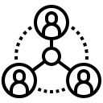
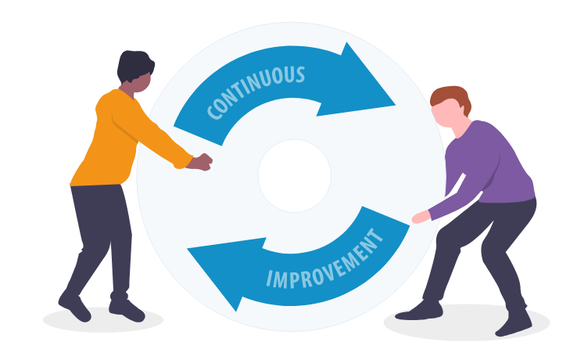
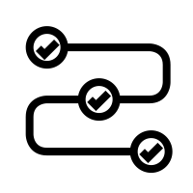
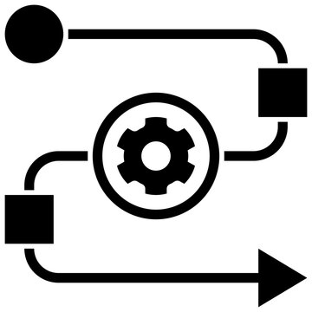
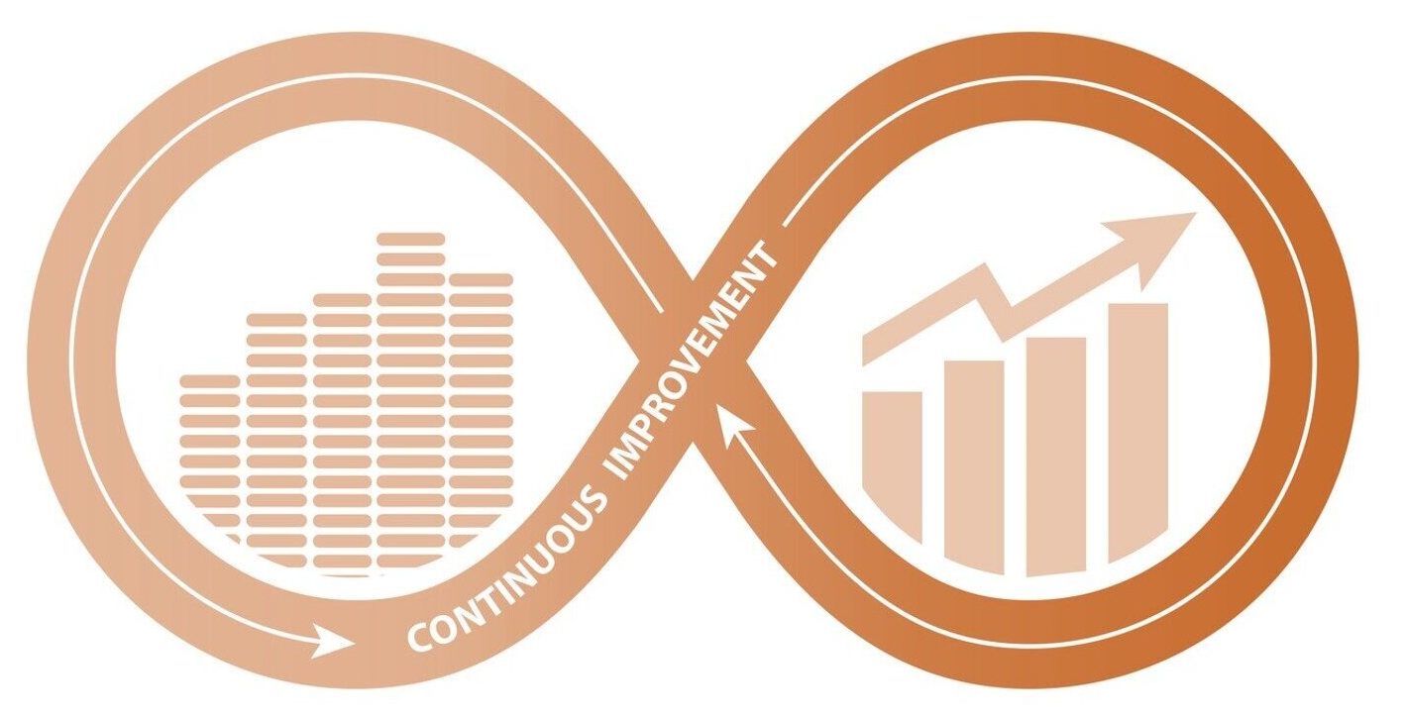
Expected Outcomes
Increase Stakeholders Value
Continuous Search for Perfection
Waste Elimination
Process Improvement
Sharing Best Practices
Cost savings aren’t the focus of Lean management, they are often an outcome.
Notes:
Outcomes
Increase Stakeholders Value (maximize the returns and benefits for those involved in or impacted by the organization's operations.
Waste Elimination
Process Improvement (staff engagement — make people feel welcome and valued)
Sharing best practices
Alignment with business strategies
Restless Dissatisfaction

